Slide 1
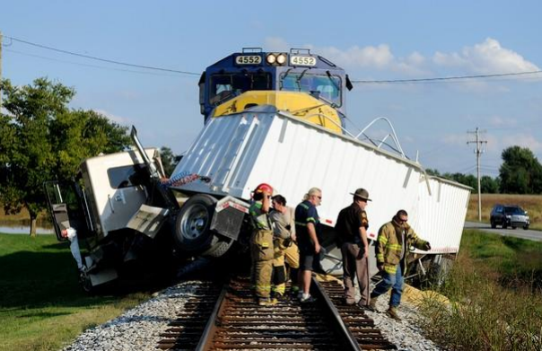
Grain Truck Driver Killed at Train Crossing
Fatality Assessment & Control Evaluation Program

Slide 2
The Victim
69-year-old male.
27 years of truck driving experience, perfect driving record.
Retired, but had taken on seasonal employment with a farm during harvest season, hauling grain.
Had been working seasonal position with same company for 6 years, was a valued team member.
Fatality Assessment & Control Evaluation Program

Slide 3
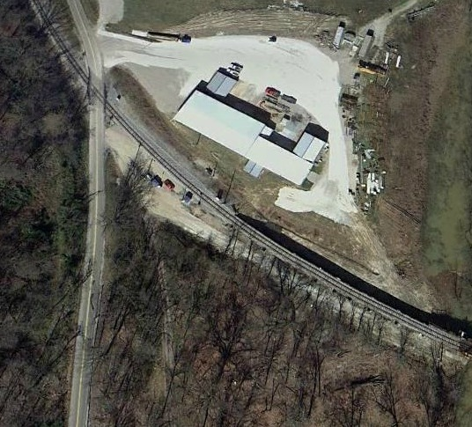
The Incident
Farm Entry
The 69-year-old victim was to haul a truckload of soybeans on a two-lane highway to meet a farmer at a barn for load delivery.
The two lane highway intersected at an angle with a railroad crossing. Just a few yards beyond the railroad crossing on the right-hand side was the farm delivery destination. The angle was such that if the driver of a truck were not conscientiously to look both ways, an approaching train could be difficult to see.
Railroad Crossing
Path of victim
Fatality Assessment & Control Evaluation Program

Slide 4
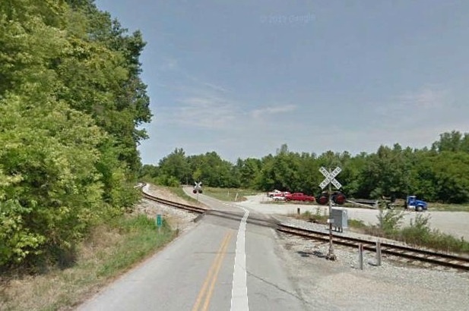
The Incident
As the victim approached the railroad crossing, it is believed that the angle of the intersection caused the approaching train to be obscured by the trucks passenger-side blind spot. It’s unknown if the railroad crossing warning lights were functioning.
The truck driver slowed to make the right hand turn into his destination, when the train collided with the truck’s passenger side. The train continued for approximately ½ mile before it was able to come to a full stop.
Fatality Assessment & Control Evaluation Program

Slide 5
The Incident
The truck driver was not wearing a seatbelt and was ejected upon impact. He was pronounced dead at the scene due to multiple blunt-force injuries.
The train conductor claimed to have sounded his horn several times before the collision took place, although four witnesses couldn’t recall hearing the horn.
Fatality Assessment & Control Evaluation Program

Slide 6
Recommendations
When approaching train tracks, truck drivers and farmers should obey all traffic guidelines and regulations pertaining to railroad track crossings.
Drivers should always wear seat belts while operating any vehicle.
Crossings should be marked and guard arms installed at all crossings.
Fatality Assessment & Control Evaluation Program

Slide 7
Recommendations
Truck drivers and farmers should consider attending an “Operation Lifesaver” education program in communities where railroad traffic is present.
Operation Lifesaver is a nonprofit, nationwide public education program designed to eliminate collisions, deaths, and injuries at highway-rail intersections and on railroad rights-of-way. It is sponsored cooperatively by a wide variety of partners, including federal, state, and local government agencies, highway safety and transportation organizations, and the nation’s railroads. More information can be fount at http://www.oli.org/
Fatality Assessment & Control Evaluation Program

Slide 8
Kentucky FACE Program
The original, full report for this incident can be found by visiting:
http://www.mc.uky.edu/kiprc/projects/KOSHS/face/data/Reports/13KY046.pdf
More occupational safety materials can be found on the Kentucky FACE website at:
http://www.mc.uky.edu/kiprc/programs/face.html
Kentucky FACE Contact Email: kyfaceprogram@uky.edu
Fatality Assessment & Control Evaluation Program

