Slide 1


Trauma-informed Approaches
for Peer Support Specialists
Notes:
v8.2025

Slide 2
Funding Statement
This project is supported by the Centers for Disease Control and Prevention (CDC) of the U.S. Department of Health and Human Services (HHS) as part of cooperative agreement 1 NU17CE010186 totaling $5.4 million with 0% financed with nongovernmental sources. The contents are those of the author(s) and do not necessarily represent the official views of, nor an endorsement by, CDC, HHS, or the U.S. government. For more information, please visit CDC.gov.
Notes:
Here is our funding statement. This work is supported by the CDC’s Overdose to Action grant through a partnership between Voices of Hope and the Kentucky Injury Prevention and Research Center (KIPRC).

Slide 3
Learning Objectives
Understand the “Three Es” Concept of Trauma
Describe an example of a trauma-informed approach you can adapt to your work role
Recognize the significance of resilience

Slide 4


Invitation to
Self-awareness
Ask yourself: How am I feeling right now?
Pause and Share
Notes:
Take a moment to check in with yourself.
Bring attention to your own thoughts and feelings.
Go to next slide: Feelings list

Slide 5
Strong Confident Capable Creative Appreciated Valuable Courageous Focused Proud Empowered Successful | Angry Frustrated Irritable Jealous Bitter Stressed Hurt Critical Enraged Annoyed Impatient | Calm Peaceful Connected Quiet Trusting Secure Thankful Relaxed Present Thoughtful Restful
Sad Vulnerable Lonely Grieving Inferior Depressed Gloomy Tired Fragile Sorrowful Remorseful | Happy Excited Optimistic Energetic Cheerful Playful Glad Joyful Satisfied Delighted Hopeful | Scared Nervous Worried Anxious Distracted Confused Distraught Insignificant Insecure Concerned Bothered
Notes:
Pick two words that describe how you are feeling right now and share in the chat or within the room.

Slide 6
Invitation to
Self-awareness
Bring attention to your own needs and take care of yourself however you need to during the presentation and after.
Notes:
Talking about trauma may evoke a range of thoughts and emotions.
Pay attention to how you are thinking and feeling throughout the presentation and take care of yourself however you need to, during and after.
We are talking about trauma and how to help others in trauma-informed ways; we are not processing trauma during this presentation.

Slide 7
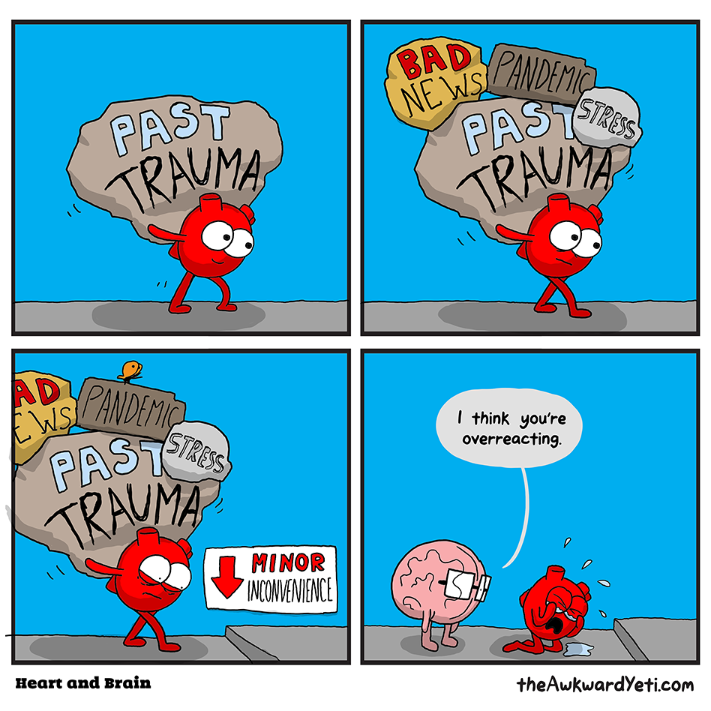
text
Notes:
This is a cartoon from The Awkward Yeti. What do you think about it and why would it be included in a presentation about being trauma-informed?
In this cartoon, Brain thinks Heart is overreacting to a minor inconvenience.
Being trauma-informed asks us to think differently and consider that there might be more to the story than what we see on the surface.
Be aware that you never know what someone is going through or what they have been through and how that impacts them today.

Slide 8
Why is it important to be trauma-
Informed?
Your work, and your day-to-day life, brings you into contact with people who have experienced trauma.
Notes:
Peer support specialists are people with lived-experience of substance use and/or mental health recovery who help others who are in recovery or seeking recovery support.
Not just you, but your co-workers!

Slide 9
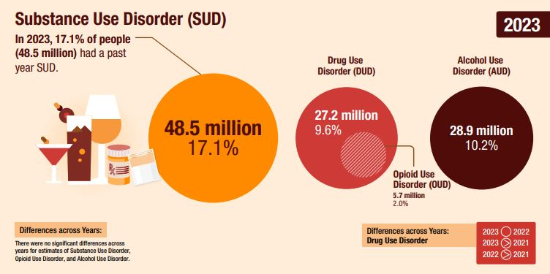
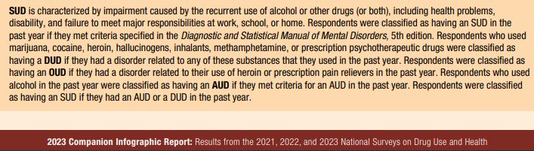
Notes:
Substance Abuse and Mental Health Services Administration. (2024). 2023 Companion infographic report: Results from the 2021, 2022, and 2023 National Surveys on Drug Use and Health (SAMHSA Publication No. PEP24-07-020). Center for Behavioral Health Statistics and Quality, Substance Abuse and Mental Health Services Administration. https://www.samhsa.gov/data/report/2021-2022-2023-nsduh-infographic

Slide 10
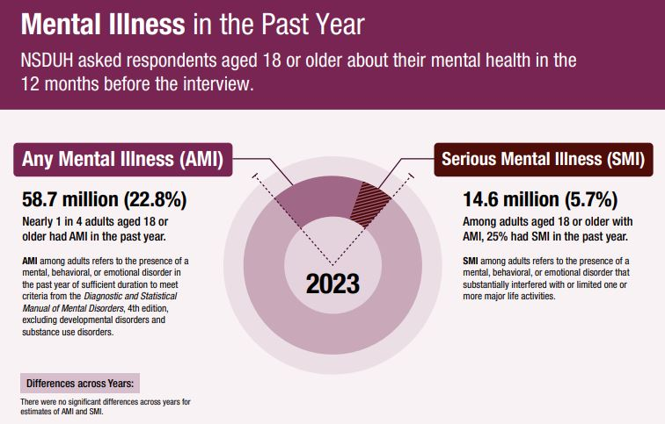
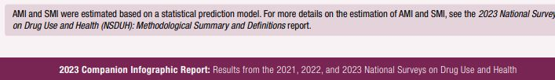
Notes:
Substance Abuse and Mental Health Services Administration. (2024). 2023 Companion infographic report: Results from the 2021, 2022, and 2023 National Surveys on Drug Use and Health (SAMHSA Publication No. PEP24-07-020). Center for Behavioral Health Statistics and Quality, Substance Abuse and Mental Health Services Administration. https://www.samhsa.gov/data/report/2021-2022-2023-nsduh-infographic

Slide 11
Why is it important to be trauma-
informed?
Trauma is pervasive
Impact is broad, diverse, and can be life-shaping
Trauma affects how people approach services
Service systems have often been re-traumatizing
Notes:
Pervasive: Extensive, common

Slide 12
What is Trauma?
Trauma results from an Event, series of events, or set of circumstances that is Experienced by an individual as physically or emotionally harmful or life threatening and that has lasting adverse Effects on the individual’s function and mental, physical, social, emotional, or spiritual well-being.
(SAMHSA Concept of Trauma and Guidance for a Trauma-informed Approach, 2014)
Notes:
Before we discuss trauma-informed approaches, let’s make sure we are on the same page and understand what we mean by trauma.
Event = Something happened
Experience = The perception of the event, how you became aware through your senses that something was happening
Effect = What happened as a result

Slide 13
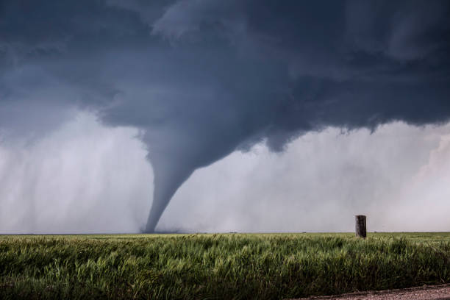
The
Three Es
of Trauma
Event
Experience
Effect
Title
Notes:
Event = Something happened
Experience = The perception of the event, how you became aware through your senses that something was happening
Effect = What happened as a result
Brook’s example:
Event: A tornado appeared in the field next to the highway while driving on a cross-country trip
Experience: Threat to life
Effect: Afraid of wind and storms, even if tornado conditions are not forecasted

Slide 14
The 3 Es
of Trauma:
Event
Events and circumstances may include the actual or perceived threat of death, serious injury, physical harm, psychological harm, or sexual violation to one’s self or someone close.
Notes:
Event can be a single occurrence or repeatedly over time.
SAMHSA Tip 57
https://library.samhsa.gov/sites/default/files/sma14-4816.pdf
SAMHSA Concept of Trauma and Guidance for a Trauma-informed Approach
https://library.samhsa.gov/sites/default/files/sma14-4884.pdf

Slide 15
Trauma Exposure
Direct experience
Witnessing the event happen to others
Hearing about someone else’s experience
Learning that a loved one was exposed
Repeat or extreme exposure to difficult scenarios (ex. social workers and counselors repeatedly exposed to details of child abuse)
Notes:
Trauma can come in many different forms. It is possible to have multiple traumas.

Slide 16
Types of Trauma
Car Accident
Race-based Trauma
Neglect
Interpersonal Violence
Mass Shooting
War
Natural Disaster
Sexual Abuse
Arrest or Incarceration
Terrorism
Historical Trauma
Human Trafficking
Emotional Abuse
Bullying
Intergenerational Trauma
Physical Abuse
Notes:
Trauma can come in many different forms. It is possible to have multiple traumas.
This is not a complete list, just a sample of examples.

Slide 17
Historical Trauma
The cumulative, multigenerational, collective experience of emotional and psychological injury in community and descendants.
Intergenerational Trauma
The transmission of trauma or its legacy, in the form of a psychological consequence of an injury or attack, poverty, and so forth, from the generation experiencing the trauma to subsequent generations. The transference of this effect is believed to be epigenetic.
Race-based Trauma
Racial trauma, or race-based traumatic stress (RBTS), refers to the mental and emotional injury caused by encounters with racial bias and ethnic discrimination, racism, and hate crimes
(SAMHSA, 2022; American Psychological Society, 2023; CDC, 2025)
Notes:
Historical Trauma examples:
Forced relocation and genocide of Indigenous Americans
Enslavement and torture of African Americans
Extermination of Jewish people during World War II
Intergenerational Trauma can include Historical Trauma, as well as circumstances as poverty, illness, attack or injury. It’s a transmission of trauma across generations.
Epigenetic refers to how your behaviors and environment can cause changes that affect the way your genes work. It doesn’t change your DNA, but changes how genes (a segment of DNA) is expressed.
Think of your DNA as a piano keyboard. The genes are the keys. Epigenetics is the piano player, deciding which key is played.
Example: Dutch Hunger Winter famine (1944-1945)
Researchers studied gene expression in people whose mothers were pregnant with them during the famine and compared it to their siblings who were born after the famine, and they were more likely to develop heart disease, schizophrenia, and type 2 diabetes.
**Important for people to recognize the trauma response to the experience of our ancestors is wired into us – epigenetics has found that the changes in gene expression caused by trauma exposure can be passed down to multiple successive generations
Race-based Trauma
RBTS is not considered a mental health disorder. It is a mental injury that can occur as the result of living within a racist system or experiencing events of racism.
Human Trafficking
Human trafficking is the act of recruiting, transporting, transferring, harboring, or receiving individuals through force, fraud, or coercion for the purpose of exploitation. This exploitation may include forced labor, sexual slavery, or other forms of commercial sexual exploitation.

Slide 18
Trauma Exposure and Substance Use Disorder
Chronic stress of seeking, using, and recovering from substance use
Family/social dynamics – repeated conflicts, deterioration of relationships, isolation
Arrests, incarceration
Grief and loss of significant relationships
Changes in self-perception (shame, self-loathing, low self-worth)
Overdoses, accidents, physical violence
Notes:
Many traumatic events are linked to the experience of substance use disorder.

Slide 19

The 3 Es
of Trauma:
Experience
Unique, individual perception of threat to one’s self or someone close
Notes:
How did you experience the event?
Two people ride side by side on a roller coaster…..
One loves it, one swears they will never do it again.
Same event, but two different experiences.
Just because you were fine, doesn’t mean the person next to you is.

Slide 20
Trauma is a Unique Experience
There might or might not be visible signs of trauma.
Everyone experiences trauma differently.
Notes:
Trauma can come in many different forms. It is possible to have multiple traumas.

Slide 21
The 3 Es
of Trauma:
Effect
Adverse, may be long-lasting, and have impact on social, cognitive, emotional, spiritual, and physical well-being.
Notes:
Adverse: Harmful, negative

Slide 22
The 3 Es
of Trauma:
Effect
Pause and Share
What are some signs and symptoms of traumatic stress?

Slide 23
Physical
Dizziness
Rapid heartbeat
Emotional
Loss of hope
Mental
Social/Behavioral
Nausea
Shortness of breath
Sweating
Body aches/pain
Anger
Feeling out of control
Guilt
Depression
Anxiety
Loneliness
Loss of meaning
Dissociation
Perfectionism
Self-hatred, self-doubt, self-pity
Feeling flooded and overwhelmed
Isolation
Irritable
Avoidance
Reliance on unhealthy coping (gambling, overspending, restricting or binging or purging food, substance use)
Signs and Symptoms of Traumatic Stress
Notes:
How does trauma impact us?
(U.S. Department of Veterans Affairs, National Center for PTSD, 2025)
https://www.ptsd.va.gov/gethelp/negative_coping.asp
Detached from your body, loss of trust, loss of self-worth, staying on guard, avoiding reminder of trauma

Slide 24

Notes:
Let’s talk about what happens inside the brain and body when it experiences stress.

Slide 25
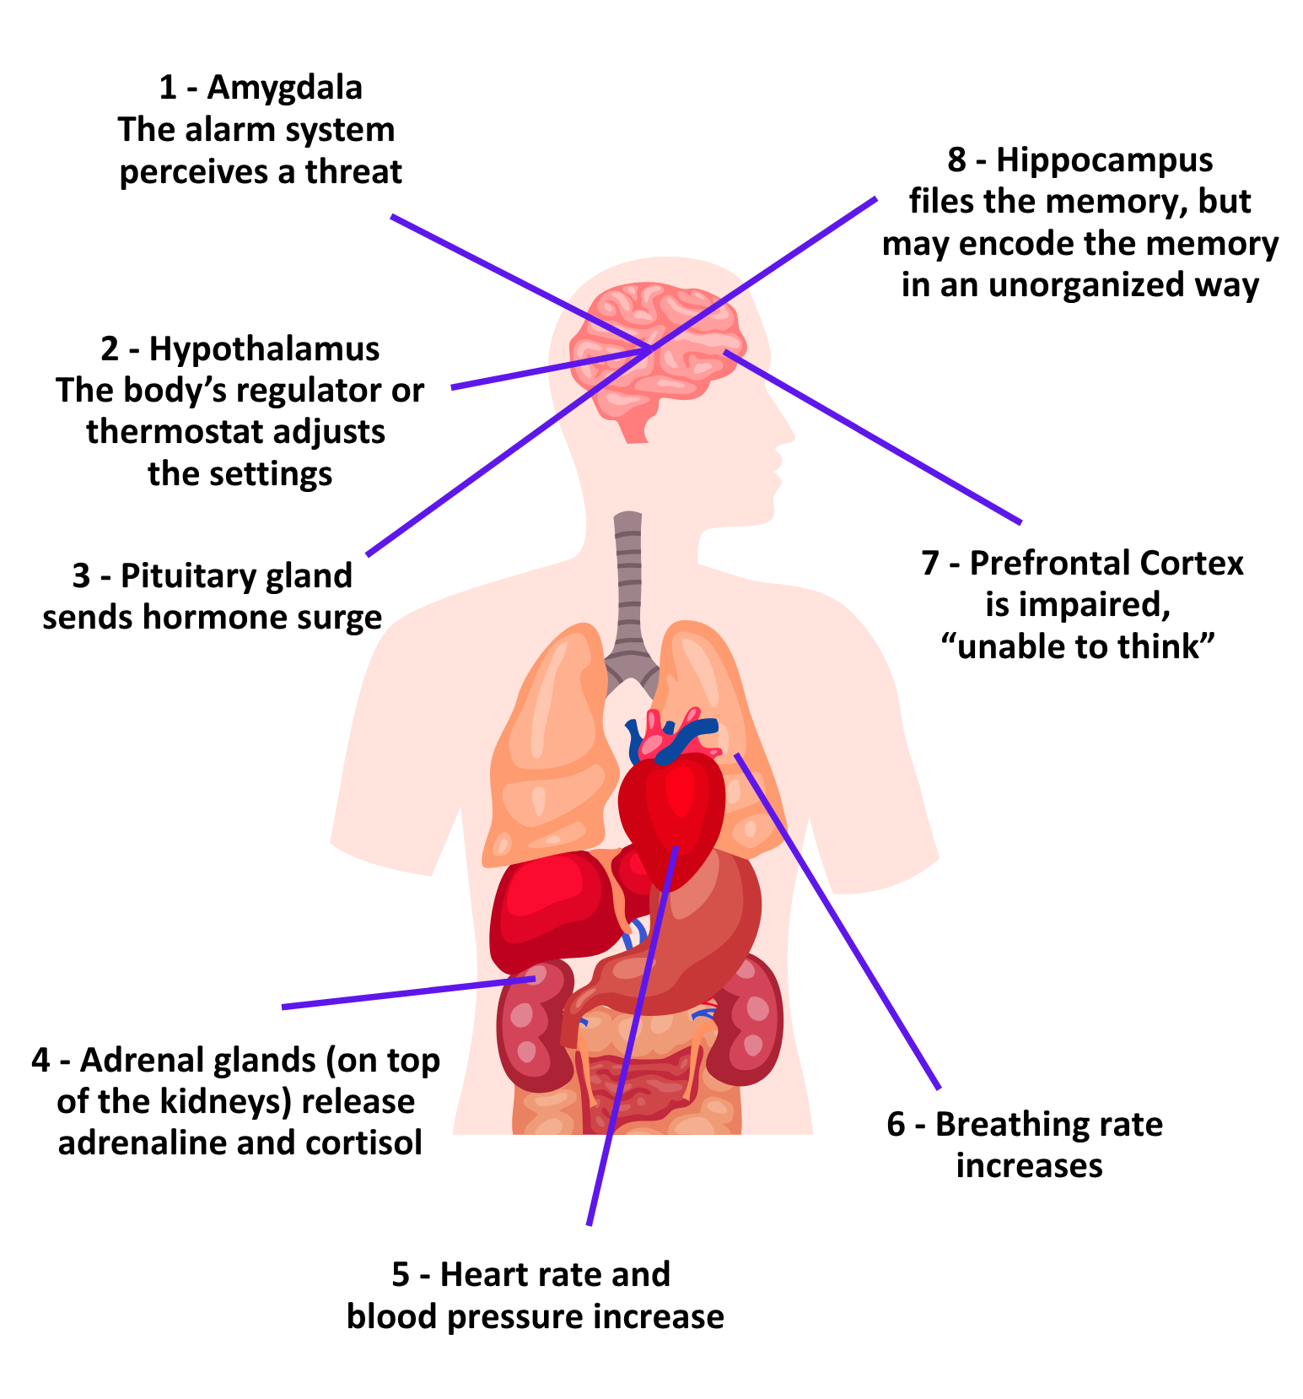
Brain-Body
Stress Response
Notes:
The stress response is automatic, complex and engages both brain and body. This is not something we choose, it’s how we are wired to react
In order to understand the effects of trauma, we need to examine what’s really going on in the brain and body when we are responding to stress.
The amygdala, the body’s alarm system, perceives the stress or threat. It sends a message to the hypothalamus that it needs to adjust the body’s settings.
The hypothalamus, the body’s regulator or thermostat. In response to this hormone release, the body kicks into action: the heart rate, blood pressure, and breathing rate all increase. Blood rushes to the muscles, pulling energy from stored fat and glucose with it.
The reason for this has to do with the hypothalamic-pituitary-adrenal axis, the brain’s and body’s stress response system that governs our fight or flight response. Hypothalamus signal to pituitary which sends a signal to your adrenal glands that says, release stress hormones! Adrenaline! Cortisol! So your heart starts to pound, your pupils dilate, your airways open up, and you are ready to either fight that bear or run from the bear. And that is wonderful if you’re in a forest and there’s a bear. But the problem is what happens when the bear comes home every night, and this system is activated over and over and over again. And it goes from being adaptive, or life-saving, to maladaptive or health damaging. Children are especially sensitive to this repeated stress activation because their brains and bodies are just developing. High doses of adversity not only affect brain structure and function, they affect the developing immune system,developing hormonal systems, and, yes, even the way our DNA is read and transcribed.
Because this all happens automatically and so fast, you don’t have time to think about what to do next. And, what we’ve learned from brain imaging is that the thinking part of the brain is not at all active during this sympathetic nervous system response to threat. This is something we are hardwired to do, without thinking.
The hormone surge also kicks the hippocampus, the filing system, into action to record and store the memory of the danger, and to seek other files of past experiences that may help to manage the current threat. But this encoding is different from the way we remember things we are consciously trying to learn. Many sights, sounds, smells, tastes, and physical sensations are being encoded but there may not be encoding of the experience in a nice, orderly fashion that we can pull up like a movie.

Slide 26
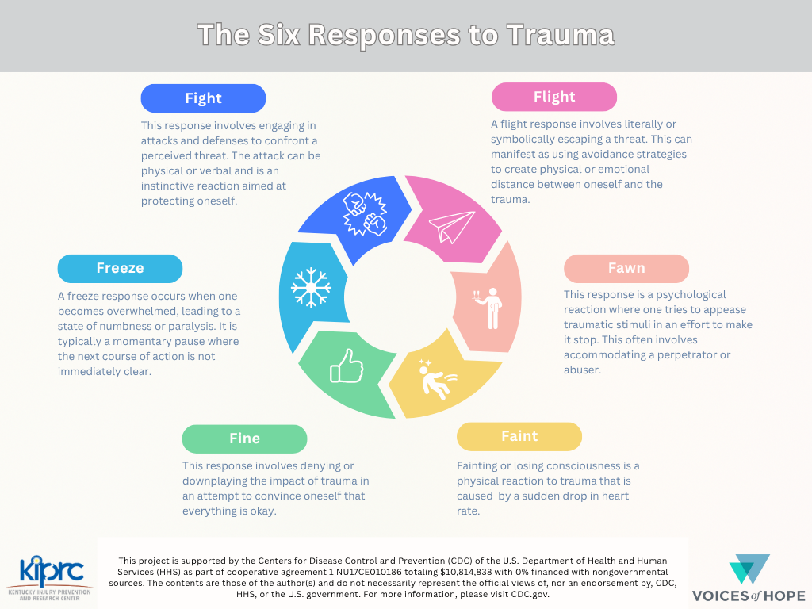
Notes:
Now let’s see what the stress response looks like from outside the body.
This happens automatically, without you having to think about it.

Slide 27
Brain Energy Allocation When Regulated
Brain Energy Allocation When Experiencing Harm
Cognition
Emotional
Cognition
Emotional
Regulation
Regulation
Survival
Survival
(Pate & Betz, 2018)
Notes:
Adapted from Holt & Jordan, Ohio DoE based on Perry, B. (2006); Courtesy of Leora Wolf-Prusan, Pacific Southwest MHTTC
Think about the population you serve. A lot of them may be in survival mode. They may not be safe enough and regulated enough to think about their emotions, behavior patterns, cognitive distortions, and thought patterns. The majority of their brain function is trying to survive.

Slide 28
How Trauma Impacts Stress Tolerance
Trauma can significantly reduce a person's tolerance for stress, leading to a narrower "window of tolerance" where they can function effectively.
This means that individuals who have experienced trauma may be more easily overwhelmed by stressful situations and may experience intense emotional and physical reactions.
Notes:
Trauma impacts how we respond to stress, even everyday stress like traffic, work deadlines, and household chores.

Slide 29
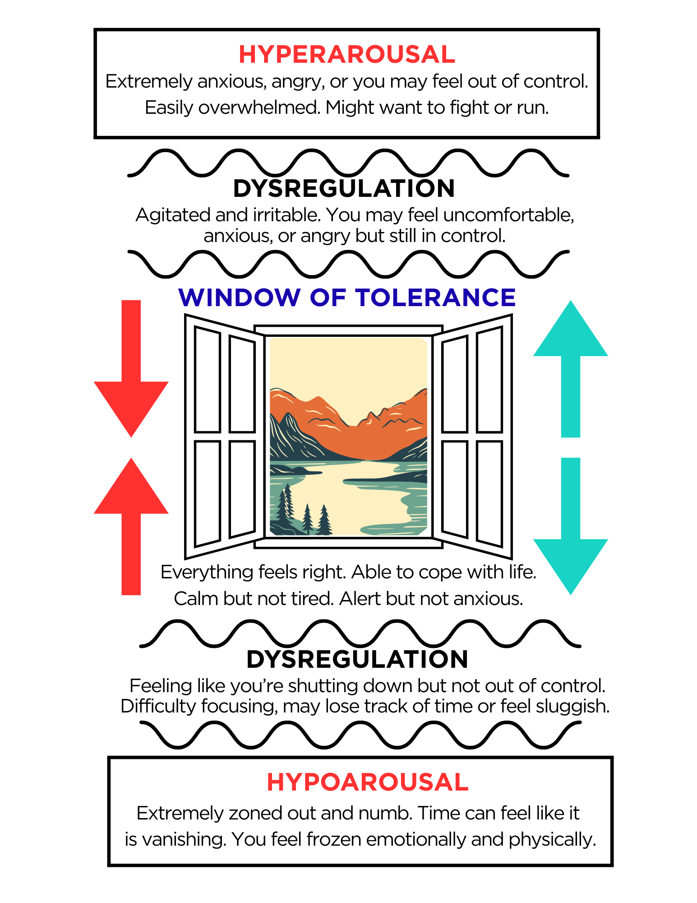
Stress and Trauma can shrink the window.
Building resilience can widen the window.
Adapted from Victim Support Services
victimsa.org
Notes:
The window of tolerance is a concept in mental health that refers to the optimal zone where an individual can function effectively and manage stress.
When someone is within the window, they feel calm, connected, and capable to cope with challenges.
Outside the window, individuals may experience states of hyperarousal (fight/flight) or hypoarousal (freeze), leading to difficulties in emotional regulation (ability to manage one’s emotional state) and overall functioning.
https://www.victimsa.org/blog/trauma-and-window-of-tolerance

Slide 30
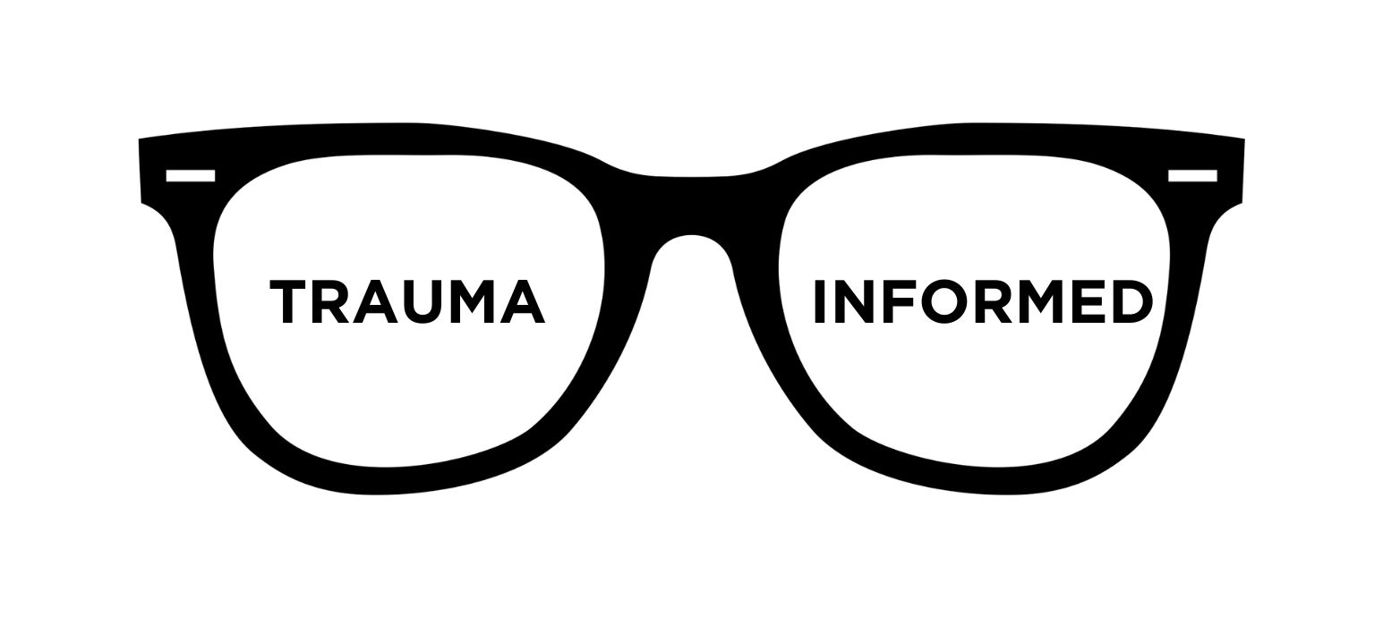
Trauma Glasses
shifting to a trauma-informed point of view
Notes:
Now that we know how common trauma is and how it impacts the ability to cope with stress, we can shift our perspective to a trauma-informed point of view.
We are going to call this new point of view: wearing our trauma glasses.
Let’s do a couple of exercises to practice wearing our trauma glasses.

Slide 31

What is your first impression of the person who lives here?
Notes:
Trauma glasses OFF—what is your first impression of this room? What assumptions did you make about the person who lives here?
Possible answers: Laziness, disrespectful, unorganized, careless

Slide 32
Trauma Glasses
ON
What do you think about the person who lives here?
Notes:
Possible answers: Overwhelmed, lacking skills about how to make decisions/what to do first/organize (never been taught to clean), depressed, loss of energy/motivation

Slide 33

Being trauma-informed asks us to shift our perspective and consider there might be more to the story.
We are not making a diagnosis.
Notes:
Remember: We are not diagnosing anyone with a mental health or medical condition (i.e. depression, ADHD, anxiety, etc.).
Being trauma-informed asks us to shift our perspective, our point of view, and consider that there might be more to the story. Being trauma-informed helps us stay open-minded and compassionate, but it does not give peer support specialists the authority or license to diagnose a medical condition.

Slide 34
A Peer Support Specialist is/does:
A Peer Support Specialist is/does NOT:
A person in recovery
Share lived experience
Help to connect participants to resources
Help participant identify goals
A role model for recovery behaviors
Encouraging, supportive, motivates through hope
Doctor/Nurse
Counselor/Therapist
Lawyer
Priest/Clergy
Family Member
Diagnose, assess, treat, or see the person as a “case”
Give professional advice
Remember the Peer Support Role
(White, 2007; SAMHSA, 2012)
Notes:
The idea of a PSS not being a "professional" is meant in the context of not being a person who is licensed to diagnose and treat substance use disorder and/or mental illness.

Slide 35
Case Study
You are the house manager at a recovery residence. Ashley has been a resident for two months and is having a hard time adjusting to the house rules. Ashley has already received two formal warnings and told she will have to leave the property if she continues to disregard the rules. You have been patient and understanding with her, until one day, she breaks a rule for the third time. You must follow protocol, telling Ashley to leave the residence and you suggest other housing resources.
Ashley says, “If you don’t let me stay here, then I’m going to kill myself.”
Trauma Glasses OFF
What do you think?
Notes:
Possible answers: manipulative, dramatic, immature, attention-seeking

Slide 36
Case Study
You are the house manager at a recovery residence. Ashley has been a resident for two months and is having a hard time adjusting to the house rules. Ashley has already received two formal warnings and told she will have to leave the property if she continues to disregard the rules. You have been patient and understanding with her, until one day, she breaks a rule for the third time. You must follow protocol, telling Ashley to leave the residence and you suggest other housing resources.
Ashley says, “If you don’t let me stay here, then I’m going to kill myself.”
Trauma Glasses ON
What do you think?
Notes:
QPR reminder! Take all warning signs of suicide seriously.
Getting needs met in ways that have worked in the past. Doing whatever is necessary to survive.
Desperate. Trying to get their needs met.
Cry for help.

Slide 37
Trauma Glasses OFF | Trauma Glasses ON
Manipulative | Getting needs met in ways that have worked in the past. Doing whatever is necessary to survive.
Lazy | Overwhelmed. Lacking skills to make decisions about what to do first or how to organize.
Resistant | Mistrustful of others due to history of being hurt by others. Scared to make progress and then lose it.
Unmotivated | Depressed or anxious. Fearful. Overwhelmed. Frozen.
Disrespectful | Feeling threatened, unsafe, out of control, vulnerable.
Attention-seeking | Feeling disconnected, alone, or unheard by others. Looking for a connection.
(Sweetman, 2022)

Slide 38
Not Trauma-informed Trauma-informed
What’s wrong with you?
People need fixing first
People make bad choices
Right and Wrong
Blame/Shame
Imposing treatment
What happened to you?
People need safety first
People who feel unsafe do unsafe things
Multiple viewpoints
Respect
Choices
(Pate & Betz, 2018)
Notes:
Pate, C., & Betz, J. (2018). Trauma-informed multi-tiered systems of support. WestEd. https://www.schoolmentalhealth.org/media/som/microsites/ncsmh/documents/archives/CS-9.15_Trauma-Informed-Multi-Tiered-Systems-of-Support.pdf

Slide 39
What
We Know
How
We Do Things
Notes:
Trauma-informed means considering how trauma impacts people while prioritizing safety to avoid retraumatizing the individual during delivery of services.
Being trauma-informed is more than being trauma-aware. We must translate what we know into how we do things.

Slide 40
Six Principles of Trauma-informed Care
Safety
Physical
Psychological
Trustworthiness & Transparency
Relationships
Operations
Peer Support
Provides hope
Promotes safety, trust, collaboration, and voice
Decisions
Collaboration & Mutuality
Levels power differentials
Values all roles
Empowerment, Voice, & Choice
Promotes resilience, healing, recovery
Cultural, Historical, and Gender Issues
Counters stereotypes, bias, historic racism, and other power imbalances
(SAMHSA Concept of Trauma and Guidance for a Trauma-informed Approach, 2014)
Notes:
These six principles are based on the work of Fallot and Harris (2009) and have been adapted by SAMHSA in the Concept of Trauma and Guidance for a Trauma-Informed Approach (2014)

Slide 41
Physical and Psychological
Safety
Safe, private space to meet with client/participant
Ask seating preference
Room temperature is comfortable
Use their chosen name and pronouns
No loud noises
Harm reduction resources to promote safer practices – educational materials, naloxone, condoms
PREA considerations
Passive communication for de-escalation
Notes:
Safety: Throughout the organization, staff and the people they serve, whether children or adults, feel physically and psychologically safe; the physical setting is safe and interpersonal interactions promote a sense of safety. Understanding safety as defined by those served is a high priority.
PREA training refers to education and instruction related to the Prison Rape Elimination Act (PREA). This training focuses on preventing, detecting, and responding to sexual abuse and harassment within correctional facilities. It aims to create a zero-tolerance environment for sexual misconduct in detention facilities.

Slide 42
“The MI Shift”
Motivational
Interviewing
Tip
Shift from feeling responsible for changing the speaker’s behavior to supporting them in thinking and talking about their own reasons for change.
Peer support specialists are responsible for how we show up.
Present, calm, approachable
Welcoming environment
Self-care
Notes:
Think about what you can control as a peer support specialist.
Cannot control your client’s desire to change or resources they use.
Cannot control the organizational policies or system

Slide 43
Relationships, Operations, Decisions
Trustworthiness
&
Transparency
Clearly communicate the process
Forms to fill out
Time of meeting, meeting location, frequency of contact, hours of operation, how they can contact you
Confidentiality – Consent forms, ROIs, HIPAA
Notes:
Trustworthiness and Transparency: Organizational operations and decisions are conducted with transparency with the goal of building and maintaining trust with clients and family members, among staff, and others involved in the organization.

Slide 44
Foundational Process of MI:
Engagement
Motivational
Interviewing
Tip
Motivational interviewing happens in the context of a relationship—two people working together.
Engaging the participant starts the process.
As you share how the process works, explain your role. Set your boundaries. Share that you are not a doctor, lawyer, counselor, sponsor, or family member. Explain how you can assist them within the process.
Notes:
Setting boundaries helps to keep you and the participant safe, is transparent, and builds trust.

Slide 45
Provides hope, promotes safety, trust, collaboration, and voice
Peer
Support
Strategically share your story
Don’t make it about you
Check on your co-workers, they are also people with lived experience
Notes:
As a peer support, your story of lived-experience with substance use and/or mental health recovery is your greatest source of hope and connection.
You are there to provide a service to the client/participant—don’t make it about you.
Peer Support: Peer support and mutual self-help are key vehicles for establishing safety and hope, building trust, enhancing collaboration, and utilizing their stories and lived experience to promote recovery and healing. The term “Peers” refers to individuals with lived experiences of trauma, or in the case of children this may be family members of children who have experienced traumatic events and are key caregivers in their recovery. Peers have also been referred to as “trauma survivors.”

Slide 46
Do not equate your experience
Motivational
Interviewing
Tip
Avoid saying: I know exactly how you feel.
Ask instead: How are you doing?
Reflective statement: That sounds difficult.
Notes:
Don’t claim to know exactly how someone feels.
Remember: everyone experiences trauma differently.
Maybe they lost a parent, and you lost a parent. Maybe they were incarcerated, and you were also incarcerated. It does not mean you know exactly how they feel.
Use your story to offer hope, but don’t claim that you have been through the exact same thing as someone else.

Slide 47
Levels power differentials, Values all roles
Collaboration
and
Mutuality
Work with other community organizations—what resources does the client need?
Help participant identify their own goals
Meet people where they are
Notes:
Collaboration and Mutuality: Importance is placed on partnering and the leveling of power differences between staff and clients and among organizational staff from clerical and housekeeping personnel, to professional staff to administrators, demonstrating that healing happens in relationships and in the meaningful sharing of power and decision-making. The organization recognizes that everyone has a role to play in a trauma-informed approach. As one expert stated: “one does not have to be a therapist to be therapeutic.”

Slide 48
Reflection Statements
Reflection statements check that you understand the other person.
Reflection statements help people feel heard and valued.
Motivational
Interviewing
Tip
• Your concern is that…
• Your fear is that…
• It seems that…
• You’re not terribly excited about…
• It’s really important to you that...
• You feel as though…
• What I heard you say was…
• It sounds like…
• You’re feeling like…

Slide 49
Empowerment,
Voice,
and Choice
Promotes resilience, healing, recovery
Validate their feelings
Don’t cause harm—do your own self-care work and be a role model for the transformative power of recovery
Empower them to make their own decisions
Notes:
Empowerment, Voice and Choice: Throughout the organization and among the clients served, individuals’ strengths and experiences are recognized and built upon. The organization fosters a belief in the primacy of the people served, in resilience, and in the ability of individuals, organizations, and communities to heal and promote recovery from trauma. The organization understands that the experience of trauma may be a unifying aspect in the lives of those who run the organization, who provide the services, and/ or who come to the organization for assistance and support. As such, operations, workforce development and services are organized to foster empowerment for staff and clients alike. Organizations understand the importance of power differentials and ways in which clients, historically, have been diminished in voice and choice and are often recipients of coercive treatment. Clients are supported in shared decision-making, choice, and goal setting to determine the plan of action they need to heal and move forward. They are supported in cultivating self-advocacy skills. Staff are facilitators of recovery rather than controllers of recovery.34 Staff are empowered to do their work as well as possible by adequate organizational support. This is a parallel process as staff need to feel safe, as much as people receiving services.

Slide 50
Affirmations
Motivational
Interviewing
Tip
Affirmations emphasize a strength, instill hope and a “can-do” attitude, are sincere and specific.
This is not cheerleading. Affirmations notice and uplift a positive character trait.
• You are a resourceful person.
• That took a lot of courage.
• You are capable of change.

Slide 51
Counters stereotypes, bias, historic racism, and other power imbalances
Cultural,
Historical,
and Gender
Issues
Radical Acceptance (meet people where they are)
Awareness of historical, intergenerational, race-based trauma
Use their preferred pronouns
Cultural humility
Person-centered language
Notes:
Cultural, Historical, and Gender Issues: The organization actively moves past cultural stereotypes and biases (e.g. based on race, ethnicity, sexual orientation, age, religion, genderidentity, geography, etc.); offers, access to gender responsive services; leverages the healing value of traditional cultural connections; incorporates policies, protocols, and processes that are responsive to the racial, ethnic and cultural needs of individuals served; and recognizes and addresses historical trauma.

Slide 52
Open-ended Questions
Open-ended questions open the door to more conversation. Open-ended questions cannot be answered with yes or no.
Open-ended questions start with: What…Where…How…Why…Tell me…
Motivational
Interviewing
Tip
X Closed Did you even want a job?
Open How does it feel to be back at work?
X Closed Have you thought about trying something different?
Open Tell me about your goals.
Notes:
Tell me more about what matters to you.
Be curious about their culture and values.

Slide 53
Trauma is not destiny.
Notes:
Talking about trauma is heavy. It can suggest that people who experience trauma cannot heal.
Well, good news! Trauma is not destiny.
We have the capacity to heal, we can re-wire our brains, we can build resilience.

Slide 54
Pause and Share
When was the last time you changed a habit?
Describe the experience. Was it easy or difficult?

Slide 55

Neuroplasticity
Neuroplasticity refers to the brain's remarkable ability to reorganize itself by forming new neural connections throughout life. This lifelong capacity for change allows the brain to adapt in response to new experiences, learning, and even in the face of injury.
It's the brain's way of rewiring itself to compensate for damage or to optimize its function based on new information and skills.
Notes:
With repetition and consistency, pathways are strengthened and new habits are developed
We all experience neuroplasticity – it isn’t always easy, and it takes time, but change does occur
Recovery is an example of neuroplasticity in action.
We can learn to play new games, learn a language, learn a new hobby (like crocheting), learn how to meditate, or exercise. Our brains can be re-wired!
When old pathways become less useful, they begin to weaken
With repetition and consistency, pathways are strengthened and new habits are developed
We all experience neuroplasticity – it isn’t always easy, and it takes time, but change does occur

Slide 56
What is Resilience?
The process of adapting well in the face of adversity, trauma, tragedy, threats, or significant sources of stress.
(American Psychological Association, 2020)
Notes:
From https://www.apa.org/topics/resilience/building-your-resilience
Imagine you’re going to take a raft trip down a river. Along with slow water and shallows, your map shows that you will encounter unavoidable rapids and turns. How would you make sure you can safely cross the rough waters and handle any unexpected problems that come from the challenge?
Perhaps you would enlist the support of more experienced rafters as you plan your route or rely on the companionship of trusted friends along the way. Maybe you would pack an extra life jacket or consider using a stronger raft. With the right tools and supports in place, one thing is sure: You will not only make it through the challenges of your river adventure. You will also emerge a more confident and courageous rafter.
American Psychological Association. (2020, February 1). Building your resilience. Retrieved from https://www.apa.org/topics/resilience/building-your-resilience

Slide 57
Connection
Wellness
Healthy Thinking
Meaning
Reflect on purpose, self-discovery, help others, proactively make and work toward goals
Learn from the past, accept change, zoom out from your perspective, optimistic outlook
Care for the physical body, mindfulness, avoid negative coping skills
Prioritize relationships, join a group, accept help
Build
Resilience
Notes:
American Psychological Association, “Building Your Resilience,” 2020

Slide 58
Stress and Trauma can shrink the window.
Building resilience can widen the window.
Adapted from Victim Support Services
victimsa.org
Notes:
Building resilience widens the window of tolerance and helps us have the ability to cope with stress.
The window of tolerance is a concept in mental health that refers to the optimal zone where an individual can function effectively and manage stress.
When someone is within the window, they feel calm, connected, and capable to cope with challenges.
Outside the window, individuals may experience states of hyperarousal (fight/flight) or hypoarousal (freeze), leading to difficulties in emotional regulation (ability to manage one’s emotional state) and overall functioning.
https://www.victimsa.org/blog/trauma-and-window-of-tolerance

Slide 59
Breathing exercises
Learn from the past
Build strong relationships
Develop your talents
Reflect on purpose
Mindfulness
Counseling
Set short-term and long-term goals
Accept change is a part of life
Care for your physical health
Advocate for your needs
Journaling
Hobbies
Join a group
Express gratitude
Help others
Notes:
There are so many things you can do to build resilience.
Mindfulness is a psychological practice that involves paying attention to the present moment without judgment. It focuses on being fully aware of one's thoughts, feelings, bodily sensations, and surroundings.

Slide 60
Build Resilience
Stress is inevitable.
Everyone has the capacity to become more resilient with the proper support and tools.
We can grow and nurture resilience.
Notes:
If you never experience adversity and are doing well in your life that doesn’t mean you are resilient, it means you are lucky.

Slide 61
Resilience Homework
Think of a time in your life when you overcame a difficult or stressful situation.
What personal strengths or resources helped you through it?
How could you apply those strengths in your current work or personal challenges?
Notes:
Goal: Reinforces a sense of personal agency and resilience already present

Slide 62
Self-care
Reminder
Engage coping strategies that help metabolize thoughts and feelings:
- Physical activity helps metabolize physiological stress response
- Express thoughts and feelings through journaling, creating art, talking
- If you are impacted in ways that feel bigger than what these coping strategies can handle, talk to a professional
Notes:
Some methods for self-care seek to take us away or avoid our discomfort.
Consider coping strategies that help us metabolize what we are experiencing, which means we have to lean into what we are thinking and feeling.
If this feels hard to you, it’s because it is. This is hard work. This is the work of building resilience.
No one can do this work for us.

Slide 63
References
American Psychological Association. (2023). Intergenerational trauma. In APA Dictionary of Psychology. https://dictionary.apa.org/intergenerational-trauma
American Psychological Association. (2020). Building your resilience. Retrieved from https://www.apa.org/topics/resilience/building-your-resilience
Centers for Disease Control and Prevention. (2025, January 31). Epigenetics, health, and disease. Centers for Disease Control and Prevention. Retrieved June 2, 2025 https://www.cdc.gov/genomics-and-health/epigenetics/index.html
Pate, C., & Betz, J. (2018). Trauma-informed multi-tiered systems of support. WestEd. https://www.schoolmentalhealth.org/media/som/microsites/ncsmh/documents/archives/CS-9.15_Trauma-Informed-Multi-Tiered-Systems-of-Support.pdf
Posluns, K., & Gall, T. L. (2020). Dear mental health practitioners, take care of yourselves: A literature review on self-care. International Journal for the Advancement of Counselling, 42(1), 1–20. https://doi.org/10.1007/s10447-019-09382-w
Substance Abuse and Mental Health Services Administration. (2012). SAMHSA Equipping behavioral health systems & authorities to promote peer specialist/peer recovery coaching services. Retrieved June 18, 2024, from https://www.samhsa.gov/sites/default/files/expert-panel-03212012.pdf
Substance Abuse and Mental Health Services Administration. (2014.) SAMHSA’s Concept of Trauma and Guidance for a Trauma-Informed Approach. HHS Publication No. (SMA) 14-4884. Rockville, MD: Substance Abuse and Mental Health Services Administration. April 23, 2025, from https://library.samhsa.gov/sites/default/files/sma14-4884.pdf
Substance Abuse and Mental Health Services Administration. (2014). Trauma-Informed Care in Behavioral Health Services. Treatment Improvement Protocol (TIP) Series 57. HHS Publication No. (SMA) 13-4801. Rockville, MD: Substance Abuse and Mental Health Services Administration.
Substance Abuse and Mental Health Services Administration. (2022). Tips for disaster responders: Understanding historical trauma and resilience when responding to an event in Indian Country (PEP22-01-01-005). U.S. Department of Health and Human Services. https://store.samhsa.gov/sites/default/files/pep22-01-01-005.pdf
Substance Abuse and Mental Health Services Administration. (2024). 2023 Companion infographic report: Results from the 2021, 2022, and 2023 National Surveys on Drug Use and Health (SAMHSA Publication No. PEP24-07-020). Center for Behavioral Health Statistics and Quality, Substance Abuse and Mental Health Services Administration. https://www.samhsa.gov/data/report/2021-2022-2023-nsduh-infographic
Sweetman, Norah. (2022). What Is a Trauma Informed Classroom? What Are the Benefits and Challenges Involved? Frontiers in Education. 7. 914448. 10.3389/feduc.2022.914448.
U.S. Department of Veterans Affairs, National Center for PTSD. (2025, January 9). Negative coping and PTSD. U.S. Department of Veterans Affairs. https://www.ptsd.va.gov/gethelp/negative_coping.asp
Victim Support Service Incorporated. (n.d.). Trauma and window of tolerance. https://www.victimsa.org/blog/trauma-and-window-of-tolerance
White, W., the PRO-ACT Ethics Workgroup, with legal discussion by Popovits R. & Donohue, B. (2007). Ethical Guidelines for the Delivery of Peer-based Recovery Support Services. Philadelphia: Philadelphia Department of Behavioral Health and Mental Retardation Services. Retrieved November 28, 2023, from https://www.naadac.org/assets/2416/whitew2007_the_pro-act_ethics_workgroup.pdf

Slide 64

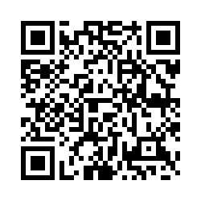
SHARE YOUR FEEDBACK WITH US
SCAN THE QR CODE BELOW!
Questions?
brook.west@voicesofhopelex.org
Request this training:
training@voicesofhopelex.org
Notes:
Evaluation link: https://uky.az1.qualtrics.com/jfe/form/SV_eeRFyEwlket7xzM

